Slide 1
IATBR webinar to discuss proposed changes to the Constitution
Wednesday, September 6, 2017
9 am Eastern Daylight Time
Presiding: Patricia Mokhtarian, Chair
Georgia Institute of Technology
patmokh@gatech.edu

Slide 2
Plan for the meeting
Background (2 slides)
Questions/comments
Overview of the proposed changes
Change 1 (automatic conference organizer appointment)
Questions/comments
Change 2 (conf. organizer term to coincide w/ conference timing)
Questions/comments
Change 3 (confirm 6 elected ordinary members, OK to have 3 from same country)
Questions/comments
Change 4 (Board discretion for minor deviations)
Questions/comments
Change 5 (minor edits)
Questions/comments
Remaining questions/comments, adjourn

Slide 3
Background (1)
Current Constitution
Current Board
Board comprises “up to four ex-officio members: a chair, vice-chair, secretary, treasurer [the latter two can be held by a single person], and between four and six elected ordinary mem­bers.
… as a minimum shall include one member from Europe, North America and Asia. No one country shall have more than two members on the Board.”
Includes past chair & potentially other appointed members
Ex-officio Members:
Elected Officers
Chair Patricia L. Mokhtarian, USA (North America)
Vice Chair/Chair-Elect Elisabetta Cherchi, United Kingdom (Europe)
Secretary/Treasurer Abdul R. Pinjari, USA (North America) – at the time of election (now India [Asia])
Appointed Board Members
Past Chair (“previously-elected”) Yoram Shiftan, Israel (Asia)
Conference Organizer Konstadinos (Kostas) Goulias, USA (North America)
Regular Board Members:
Caspar Chorus, The Netherlands (Europe)
Charisma Choudhury, United Kingdom (Europe)
Matthew Roorda, Canada (North America)
Junyi Zhang, Japan (Asia)
Notes:
Current geographic distribution of the Board: North America 4 (counting Abdul); Europe 3; Asia 2 (not counting Abdul)

Slide 4
Background (2)
The rules have become a bit restrictive, sometimes precluding interested people from running for election to the Board at all, and sometimes presenting compli­cated contingencies, such as
“If person X is elected as an officer, that will preclude person Y from being elected as an ordinary member even if s/he has the most votes, because person X would already be the second Board member from the same country.”
The primary purpose of the proposed changes is to somewhat relax these restrictions, while remaining true to the principles of geographic diversity and non-dominance of any one country.
While we’re at it, it could be helpful to make a few other small changes that are also related to the composition of the Board.

Slide 5
Questions or comments on background?

Slide 6
Overview of the proposed changes
Make automatic the appointment of the international conference organizer to the board.
Reduce the number of discretionary appointments to the Board from three (which included the conference organizer) to two, specified (as already in the Constitution) to be Newsletter editor and Website editor.
------------------------------------------------------------------------------------------------------------------------------------------------------------------------ 
Specify the term of the conference organizer to coincide with conference periods.
------------------------------------------------------------------------------------------------------------------------------------------------------------------------ 
Specify six elected ordinary members of the Board, instead of “between four and six”.
Allow three (elected) members to be from the same country, as long as no more than two officers are from a single country.
------------------------------------------------------------------------------------------------------------------------------------------------------------------------ 
Explicitly give the Board the authority to approve minor deviations from the rules for cause.
------------------------------------------------------------------------------------------------------------------------------------------------------------------------ 
Minor edits for clarity/logic/grammatical correctness.

Slide 7
Proposed Change 1
Make automatic the appointment of the international conference organizer to the Board.
Currently, it is an option for the Board, but we have been regularly exercising that option for years, and it seems reasonable to make it a permanent feature.
AND
Reduce the number of discretionary appointments to the Board from three (which included the conference organizer) to two, specified (as Constitution already states) to be Newsletter editor and Website editor.

Slide 9
Questions or comments on proposed Change 1?

Slide 10
Proposed Change 2
Specify the term of the conference organizer to coincide with conference periods.
The terms of the elected members are two or four years; the term of the conference organizer is currently unspecified. It is naturally desirable to have the conference organizer represented on the Board during the entire conference organizational period (which is presently three years).

Slide 11
Questions or comments on proposed Change 2?

Slide 12
Proposed Change 3
Specify six elected ordinary members of the Board, instead of “between four and six”.
The organization is large and stable enough to justify the larger number.
Allows for greater participation and diversity on the Board.
Given that there are 5-6 ex-officio members (3-4 officers + past chair + conference organizer), it seems reasonable to have at least as many regular members as ex officio ones.
AND
Allow three “currently-elected” Board members to be from the same country, as long as no more than two currently-elected officers are from a single country. The immediate past chair is considered a “previously-elected” but now appointed ex officio member of the Board, and is not counted in the enforcement of this provision.
With the expansion of the Board to 9-10 elected members (plus the past chair & conference organizer as appointed mem­bers), allowing at most three from a single country would still be far from domination.
It is not just the US that might end up with three elected members on the Board: several other countries also have thriving (and/or growing) travel behavior research communities, and could end up in this position now or over time.
Preserves the current requirement of at least one elected member from each of Europe, N. America, and Asia, so a minimum of geographic diversity is still ensured.
Notes:
As you saw earlier, we currently have 4 elected ordinary members, so this proposed change would mean an *expansion* of the *current* size of the Board, although not an expansion *beyond what the Constitution already allows*

Slide 13
Geographic distribution of IATBR members
USA | 64 | Not specified | 5
UK | 41 | Belgium | 4
Australia | 26 | Greece | 4
The Netherlands | 25 | Italy | 4
Canada | 24 | Hong Kong | 3
Switzerland | 17 | Portugal | 3
Japan | 15 | Brazil | 2
Germany | 14 | Ireland | 2
Sweden | 12 | Spain | 2
Chile | 8 | Austria | 1
Israel | 8 | Estonia | 1
Singapore | 8 | South Korea | 2
China | 7 | Taiwan | 1
Denmark | 7 | TOTAL | 316
France | 6
North America (88)
Europe (143)
Asia (44)
Australia (26)
South America (10)
Notes:
If anyone’s concerned about N. American domination, consider that as a bloc, the Europeans outweigh N. and S. America + Asia combined!

Slide 14
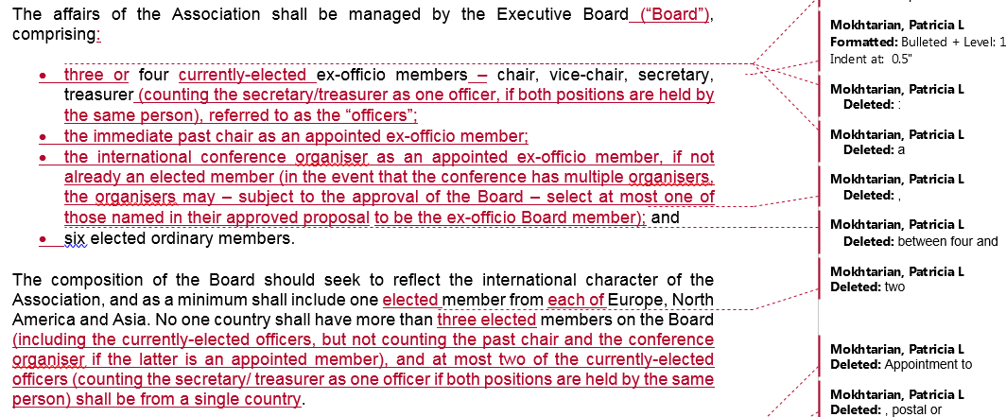

Slide 15
Questions or comments on proposed Change 3?

Slide 16
Proposed Change 4
Explicitly give the Board the authority to approve minor deviations from the rules for cause, such as to provide representation for a region of the world that is not covered by the election procedures, or, in the case of a tie, to allow both parties to be elected.
The Board may face situations not specifically addressed by the Constitution. The Board currently has “the right to co-opt up to three ordinary members … for specific purposes …”, but it is desirable to provide flexibility beyond the particular purposes listed.
AND
Eliminate the following provision of the Constitution (which is superceded by the new provision):
“Additionally the Executive Board would have the right to co-opt up to three ordinary members for a maximum of two years at a time for specific purposes:
organisation of an International Conference, or other specific event
to ensure representation for a region of the world which is not covered by the election procedures.”

Slide 18
Questions or comments on proposed Change 4?

Slide 19
Proposed Change 5
Accept minor edits that are not otherwise affected by the proposed changes above. Any constitutional text not shown in the reference document remains unchanged.

Slide 20
Questions or comments on proposed Change 5?

Slide 21
Any other questions / comments? (Can send to apinjari@usf.edu, cc patmokh@gatech.edu) Thanks for your time and consideration, and please vote! Meeting adjourned!

